Slide 1

Expense Tracker Android App:
Developer:
Tawsif Rahman Shopnil
ID:1110024
Team Members:
Sayma Khorshed Chowdhury
ID:1110003
Khaled Saifullah Fahad
ID:1110019

Slide 2

What this App Does?
Tracks Income.
Tracks Expenses.
Shows the overall summery of incomes and expenses according to Day.

Slide 3
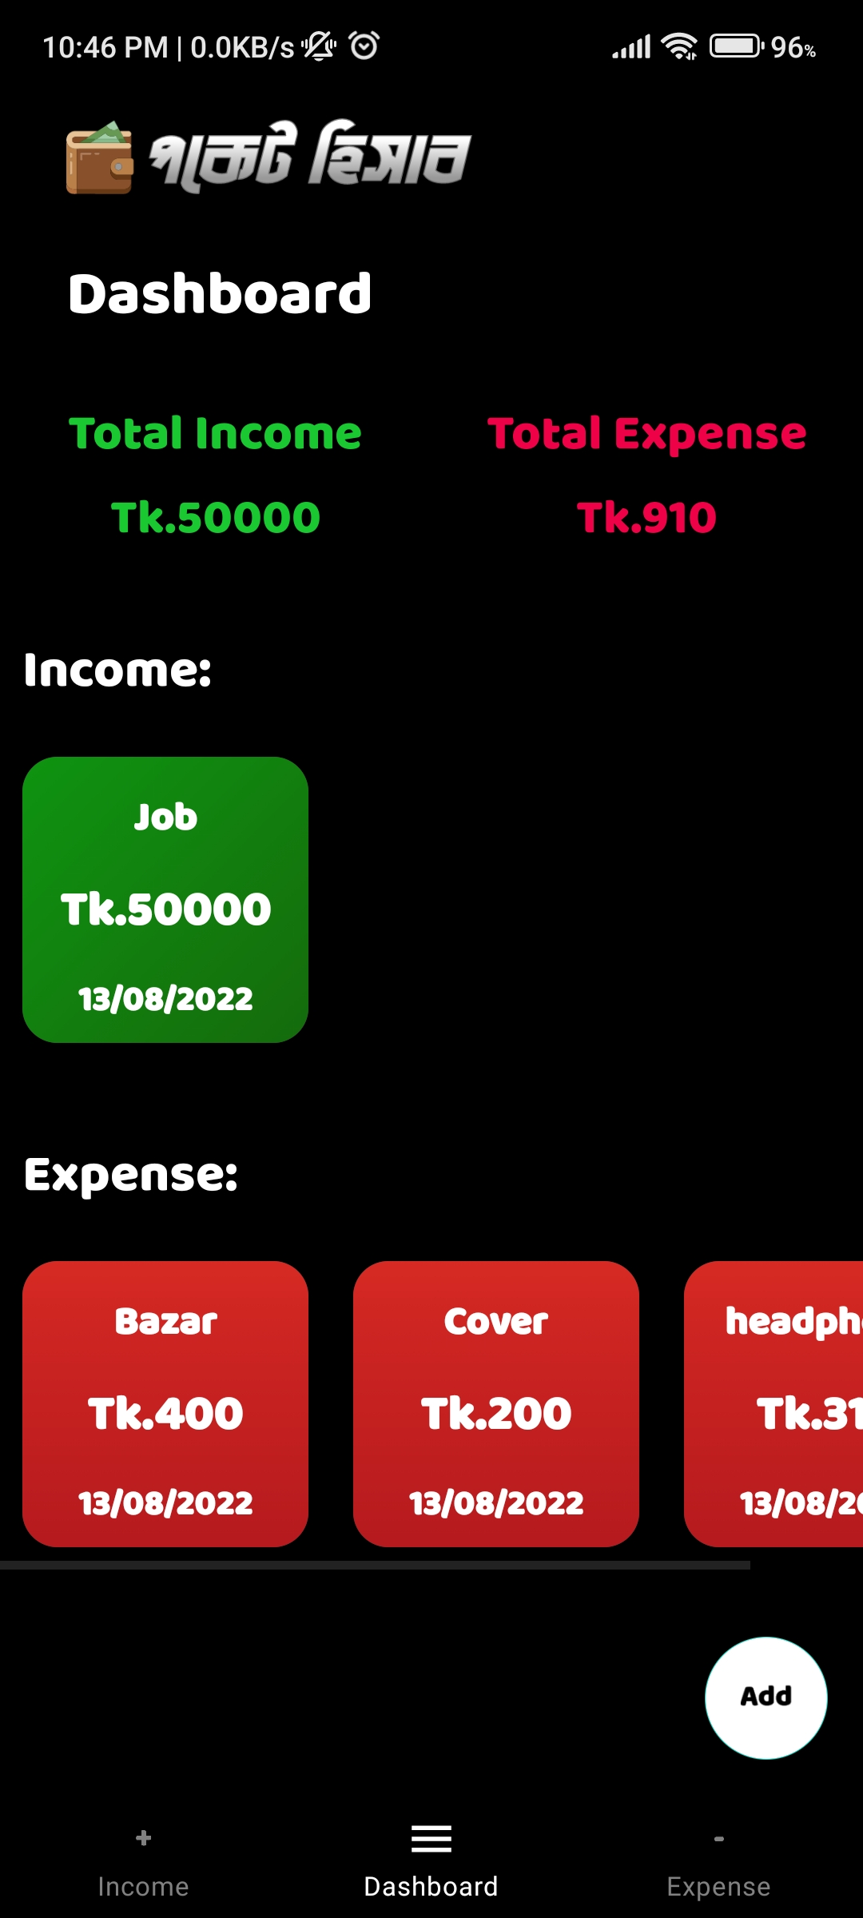
Dashboard
Total income count
Total Expense count
Income Card view(Recycler View)
Expense Card View(Recycler View)
Floating action button for adding income and Expenses

Slide 4
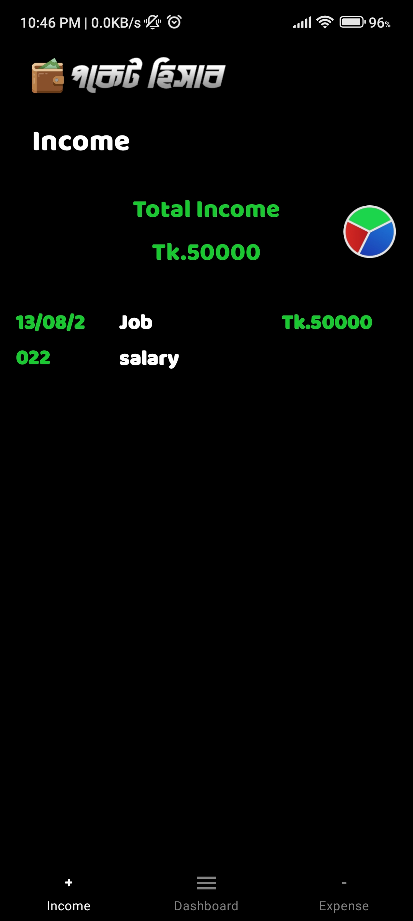
Income Fragment
Total income count
Pie Chart button for Pie chart view
List view of Incomes Summery in details

Slide 5
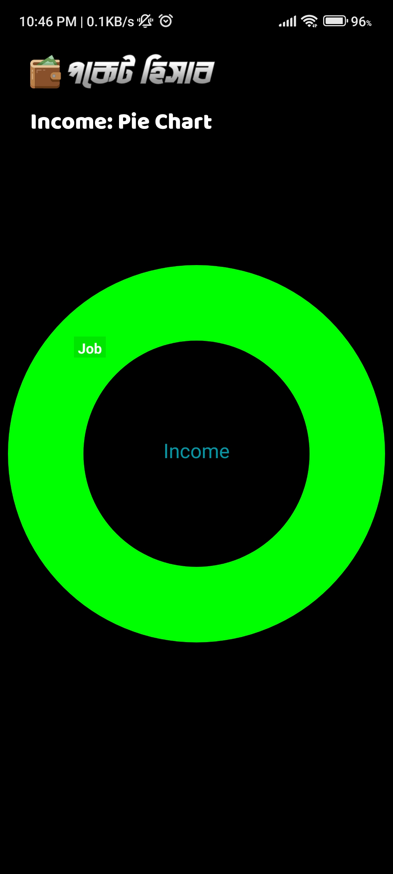
Income Pie chart
Logo
Text
Pie Chart

Slide 6
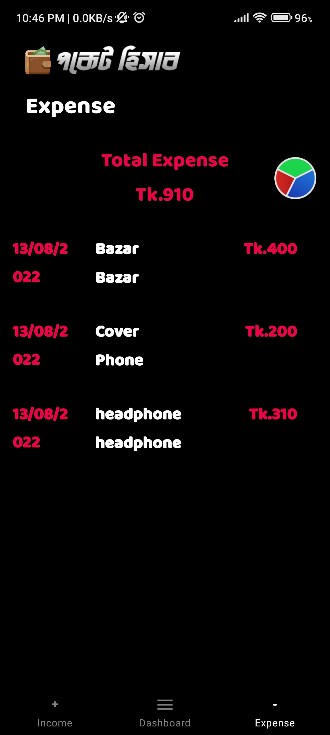
Expense Fragment
Total expense count
Pie Chart button for Pie chart view
List view of expense Summery in details

Slide 7
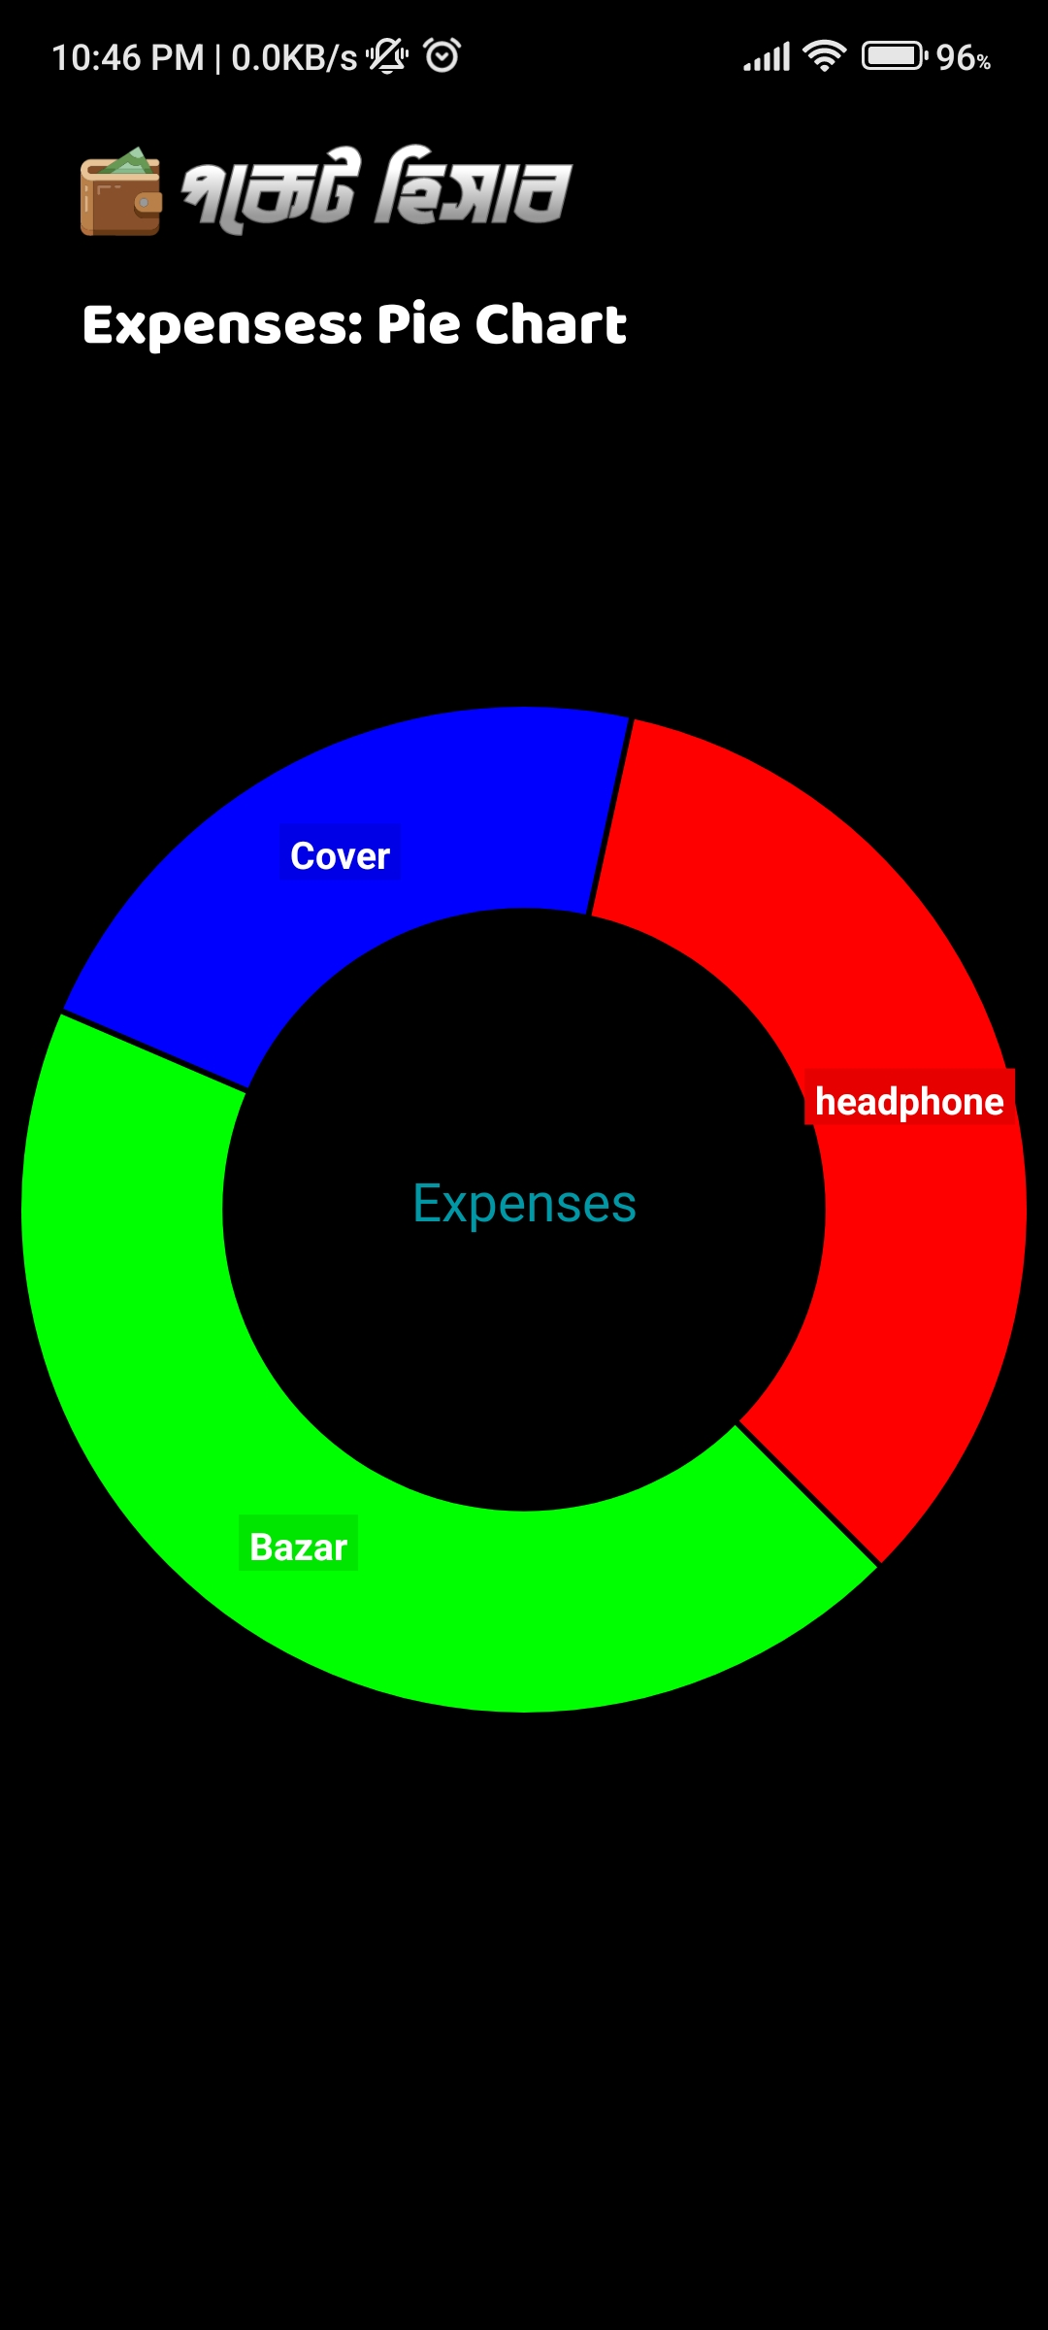
Expenses Pie chart
Logo
Text
Pie Chart

Slide 8
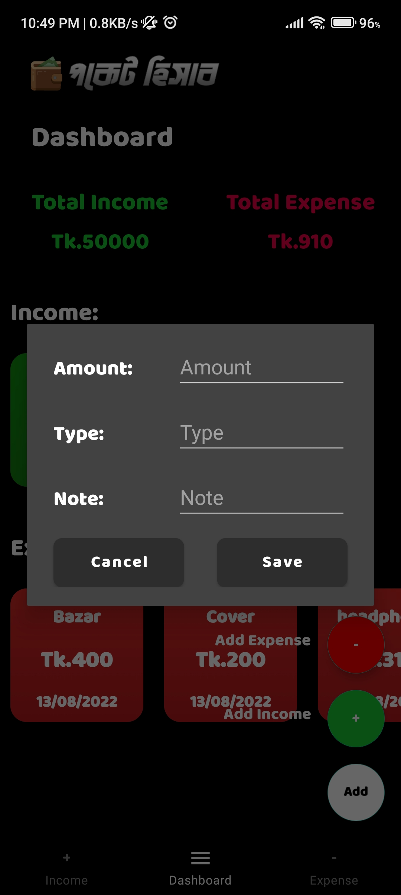
Add Item
Amount, Type and Note as edit text
Cancel and Save buttons

Slide 9
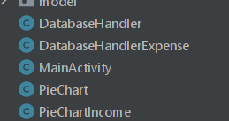
About Database
It has 2 SQLite Databases and it’s Controller Module:
1. DatabaseHandler
Manages and stores income information
2. DatabaseHandlerExpense
Manages and stores expense information

Slide 10

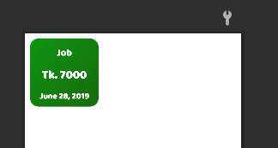
Custom Designed Layouts
Expenses
3 textViews for purpose, amount and date.
Designed in Relative Layout.
Income
3 textViews for purpose, amount and date.
Designed in Relative Layout.

Slide 11

Bottom Navigation Bar
Expenses
Navigation button that is in Fragment and if
clicked goes to Expenses fragment
Income
Navigation button that is in Fragment and if
clicked goes to Income fragment
Dashboard
Navigation button that is in Fragment and if
clicked goes to Dashboard

Slide 12
Thanks!

